Slide 1
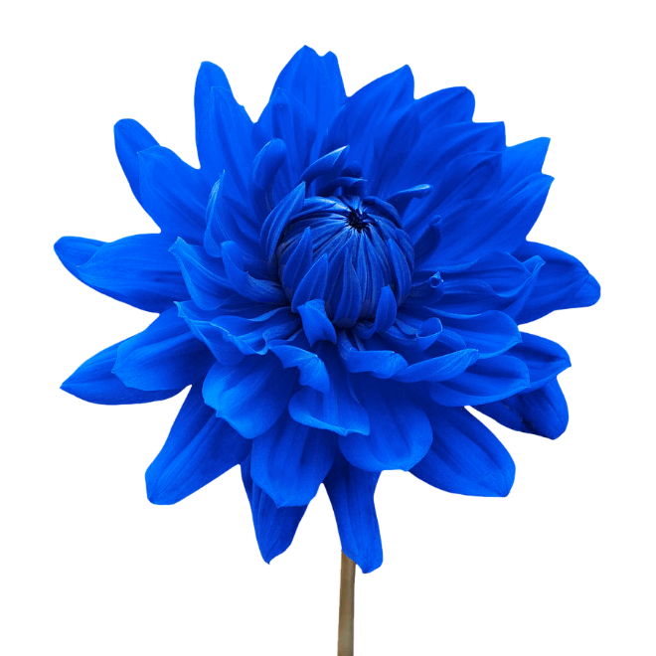
Welcome

Slide 2
Identity
Presented by
Afroza nasreen sultana
Assistant Teacher
Govt high school
Bangladesh .
Class : Eight
Science
Chapter:5

Slide 3
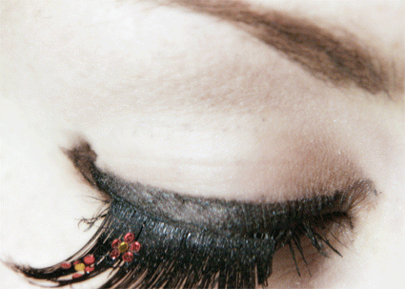
What can you see in this picture?
Notes:
Teacher may ask about the picture first to take out the lesson name.

Slide 4
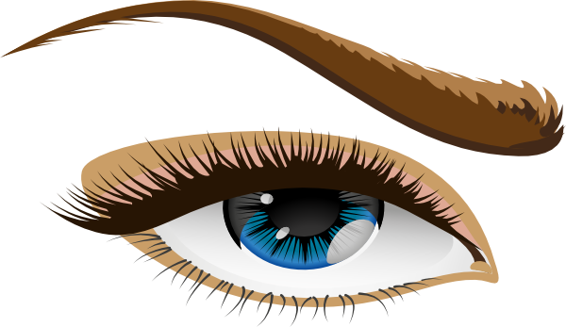
Lesson Declaration
Today we `ll discuss about
Human Eye

Slide 5
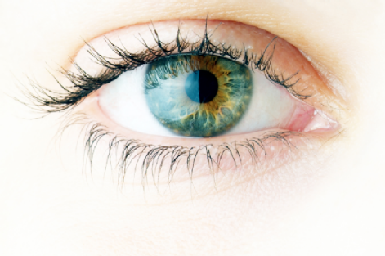
Lesson Objectives:
After viewing this presentation you will be able to---
Location of human eye
Explain the structure of human eyes
Describe function of human eyes

Slide 6
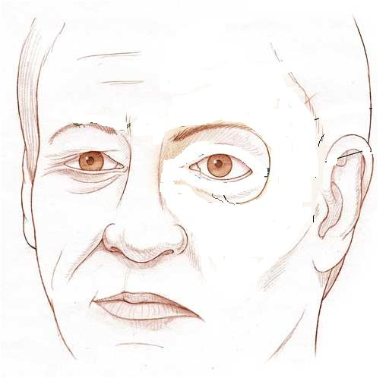
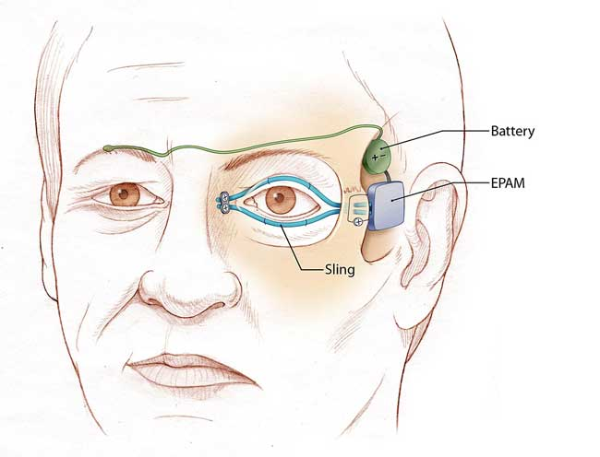
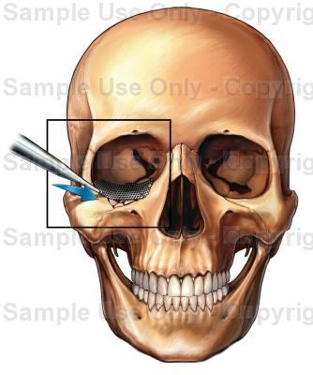
What can you see in this picture?
Two eyes in front of head, Which is situated in eye cavity.

Slide 7
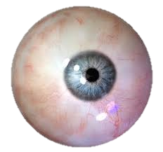
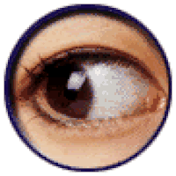
What do you see in this picture ?
What is its name ?
In the cavity of the eye there is a spherical object which can be rotated within a certain limit
Image shape round , like a ball.
It is known as eye ball

Slide 8
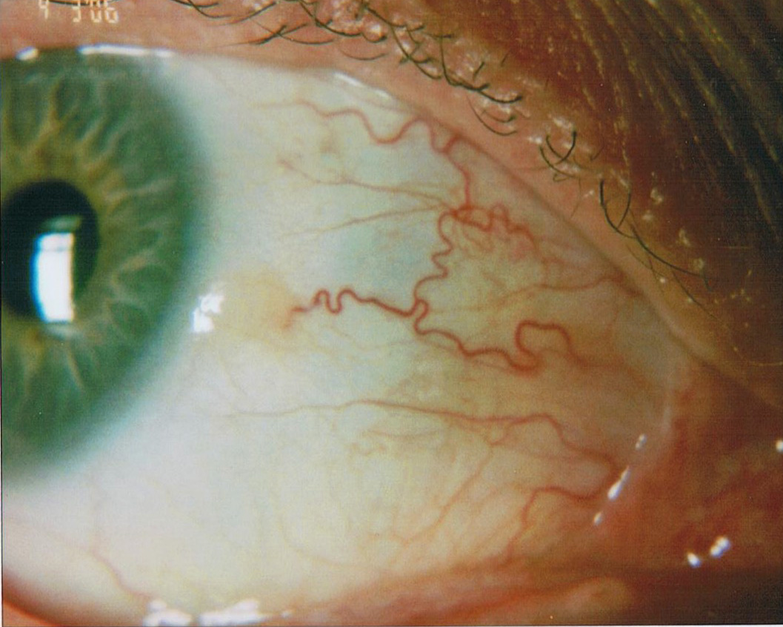
How does it work?
Which parts can you see in these picture’s?
What is its name ?
?
?
Sclera
It protects the eye from external harmful effects and preserves the shape of the eye.
This is a white covering of the eye-ball which is hard, fibrous and opaque.

Slide 9
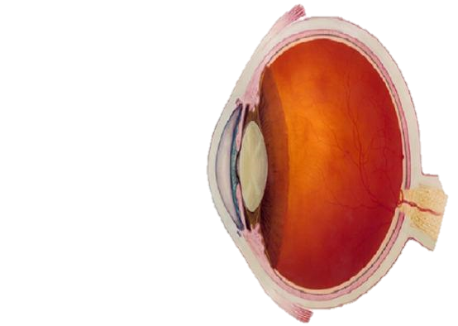
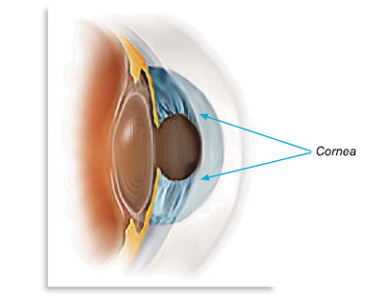
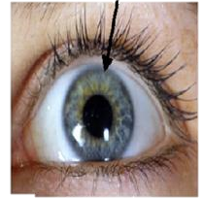
What do you see in this picture ?
What is its name ?
Cornea
Frontal part of the sclera
This part of the sclera is transparent and is bulged outwards more than other parts

Slide 10
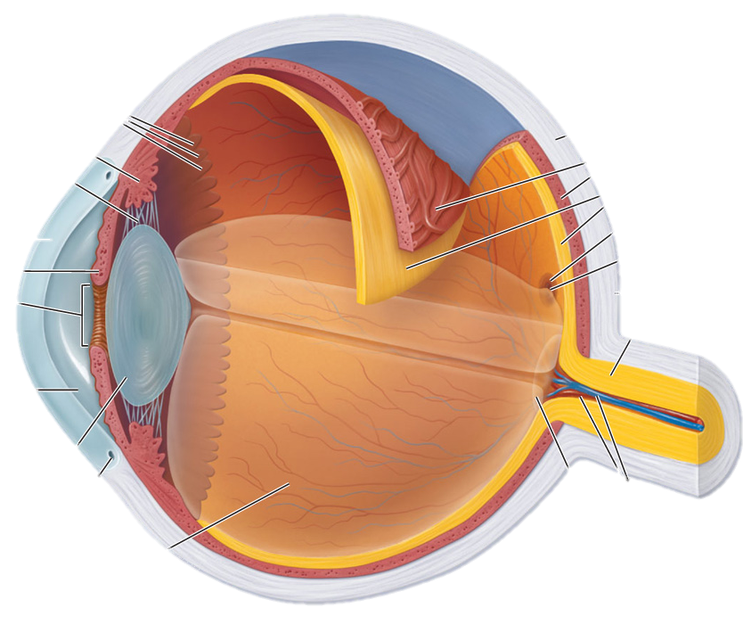
What do you see in this picture ?
What is its name ?
?
It is a black membrane covering the body of sclera. Because of its blackness, the light entering the eye is not reflected.
Choroid

Slide 11
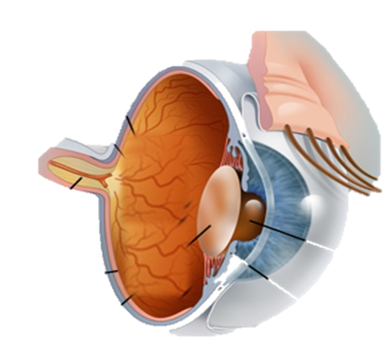
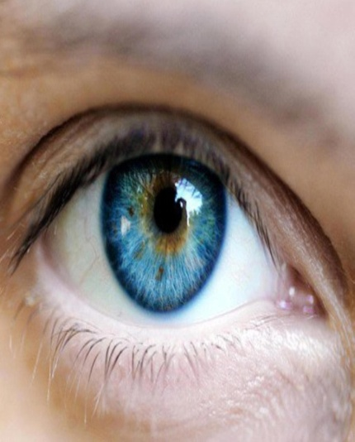
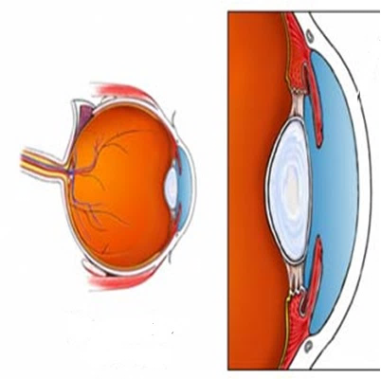

What do you see in this picture ?
What is its name ?
?
?
Iris
It is an opaque membrane which stays just
behind the cornea.
This membrane can be of different colour like blue, deep brown, black etc. for different persons.

Slide 12
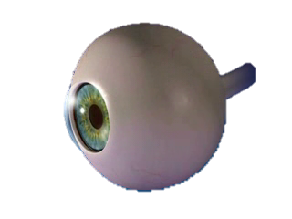
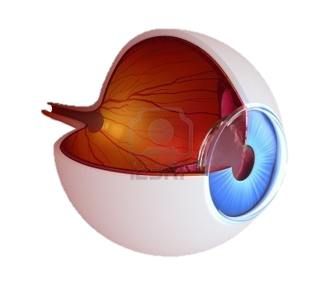
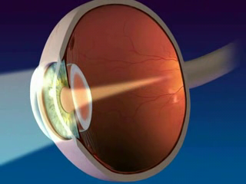
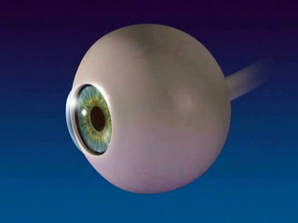
What do you see in this picture ?
What do you see in this picture ?
What is its name ?
What is its name ?
Pupil
Crystalline convex lens
It is a circular hole at the centre of the cornea which is connected to muscular cells.
This is a convex lens made of soft jelly like material which is situated behind the cornea.
The size of the aperture of the pupil can be adjusted by the movement of the muscles attached to it.

Slide 13
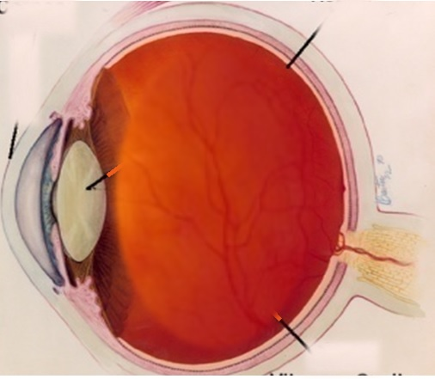
What do you see in this picture ?
What is its name ?
?
Retina
It is a light sensitive rose coloured translucent membrane located behind the eye-ball. When light falls on retina it creates some excitements in those nerves and produce the sensation of sight in the brain.

Slide 14
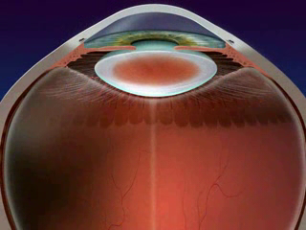
What do you see in this picture ?
?
The space between the lens and the cornia is filled with some kind of transparent watery substance. This is called aqueous hummour.
The space between the lens and the retina is filled with jelly like material. This is called vitreous hummour.

Slide 15
Group work:
Time : 10 minute
Now we watch a video clip
https://www.youtube.com/watch?v=BEtdh-G8wFE
Make a chart Internal structure and function of human eye ?

Slide 16
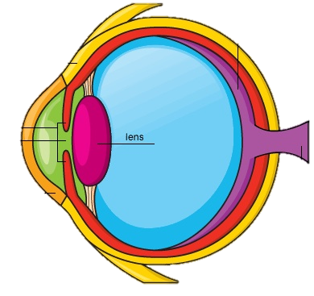
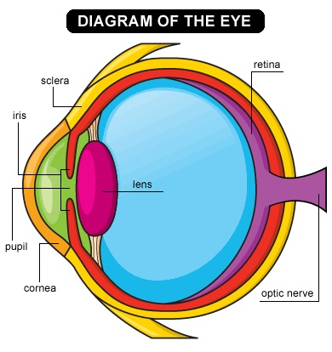

Evaluation :
?
?
2
1. What is the name of arrow mark pathway ?
a) Sclera b) Pupil
c) Irish d) Choroid
. What is the reason for the green eye?
a) Retina b) Pupil
c) Irish d) Choroid
How does it works ?

Slide 17

Home work
Compare between an eye and a camera.

Slide 18
Thank you

